Slide 1



K. J. Somaiya Institute of Engineering & Information Technology, Mumbai
Department of AI-DS
Academic Year 2022-23
Crime Prediction Model
Shubham Agarwal - 01

Slide 2
Outline of Project
Introduction
Problem statement
Project Objective
Literature Survey
Finding of Literature Survey
Gantt Chart
Proposed System
Software Requirement
System design
System Implementation
Results
Conclusion
Future Scope
References

Slide 3
Introduction
Crime scene analysis (crime analysis) is the analytical process of interpreting the specific features of a crime and related crime scenes.
It involves an integrated assessment of the forensic evidence, forensic victimology, and crime scene characteristics.
The results of crime scene analysis (CSA) may be used to determine the limits of the available evidence and the need for additional investigative and forensic efforts, as in a threshold assessment

Slide 4
Problem Statements
Inappropriate Crime Price Prediction can lead to the following Problems
Real Estate companies can’t sell enough houses thus results in heavy losses and sometime even bankruptcy
False price prediction can lead to bad investment for the buyers
As in India Real Estate contributes 6-7% to the GDP , thus the real estate sector plays a very critical role in the economy

Slide 5
Project Objective
Why Crime Prediction ML Model ?
The objective of this project is to analyse dataset which consist of numerous crimes and predicting the type of crime which may happen in future depending upon various conditions.
In this project, we will be using the technique of machine learning and data science for crime prediction of crime data set. It consists of crime information like location description, type of crime, date, time, latitude, longitude

Slide 6
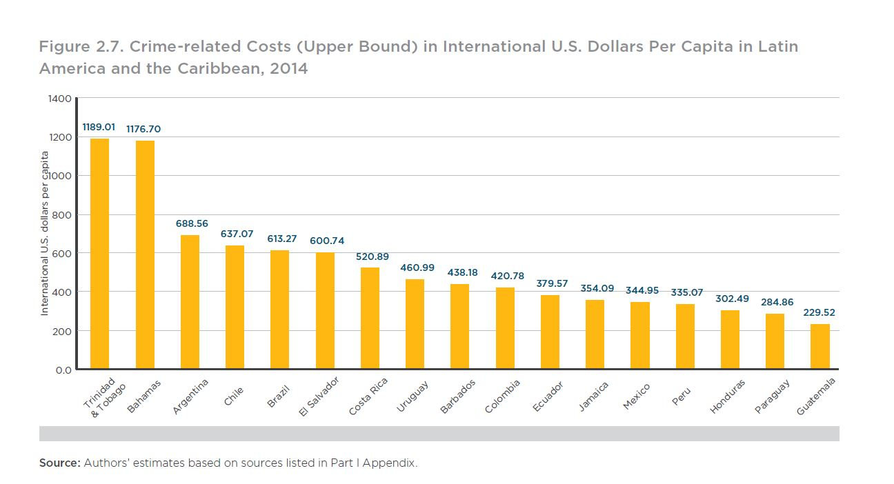
Literature Survey

Slide 7
Finding of Literature Survey
In the past, there have been many such systems, where crime data is analysed using different algorithms, mainly K-Means, K-Medoids, KNN etc.
Some of the models and methodology are explained: The authors, Jain et al. in their paper “Crime Prediction using K-Means Algorithm” , have used K-means clustering algorithm to find out patterns from the crime dataset.
K-Means clustering algorithm is distance based algorithm. The Euclidean distance metric is used to find the distance of a point from the nearest centres and decides if that point should belong to the cluster or not.
The number of clusters cannot be determined at the start of the algorithm. Hence various iterations of K-Means have to be performed. The authors have used Rapid Miner tool for analysis because of its flexibility and scalability. The main aim of the analysis was to understand which year was the crime rate highest and lowest. Supporting this information, bar graphs are plotted for each cluster.

Slide 8
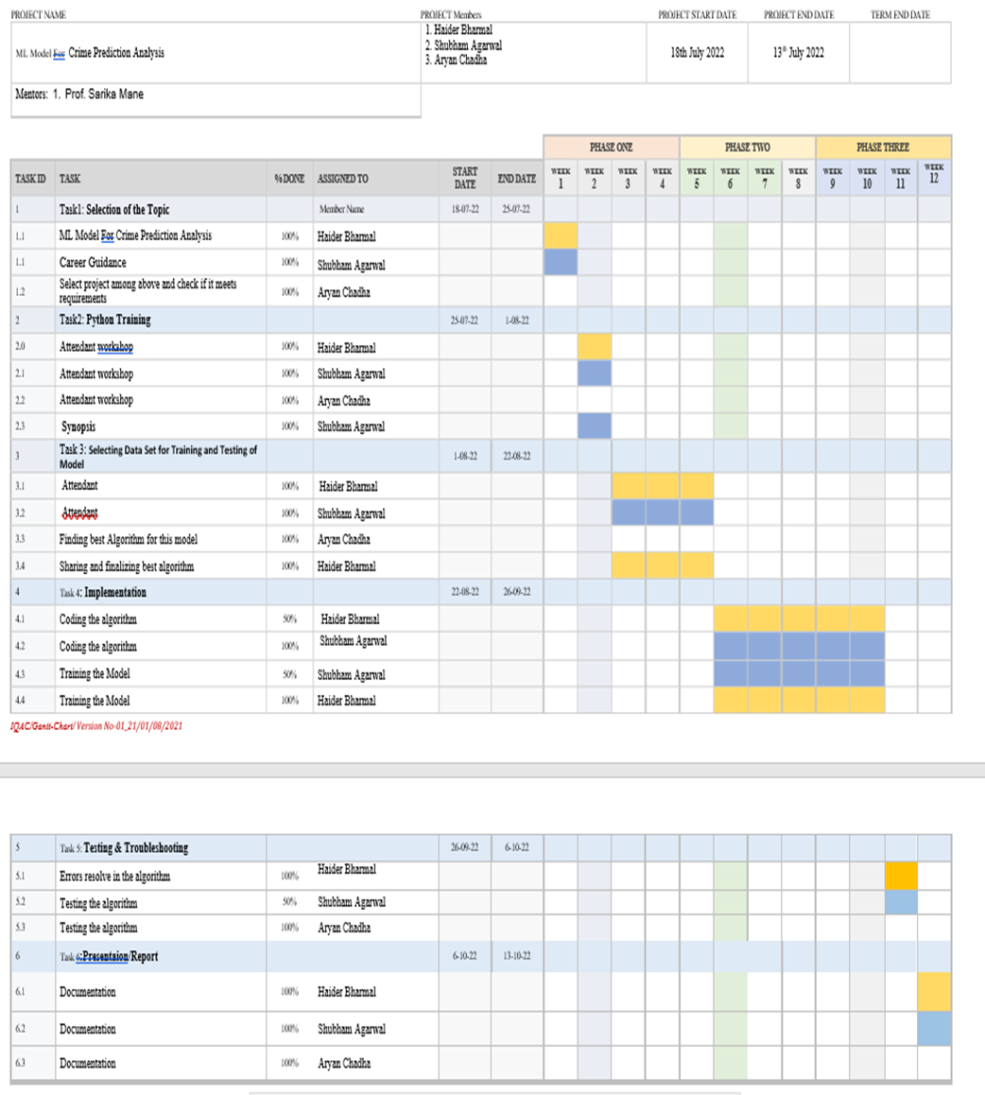
Gantt Chart

Slide 9
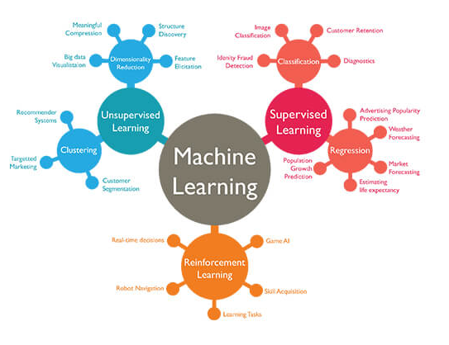
Software Requirements
Using the following Python Modules
Pandas : for analyzing, cleaning, exploring, and manipulating data
Matplatlib : for graphical representation of dataset and better analysis of dataset
Sklearn : ML Library containing various Features like Regression and many more
Jupyter Note Book : To create and share the document containing live code , graphs and visualizations
Others : A data set for training and testing model

Slide 10
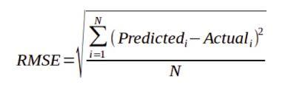
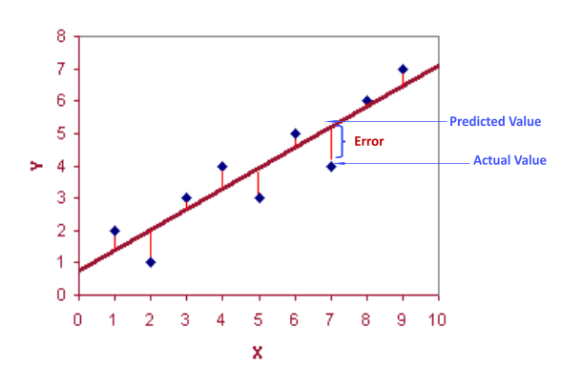
System Design & Implementation
The ML Model is build using Supervised Learning Method Since it has Features and labels
Since we have to predict prices (Values) thus basic task is regression hence we used RMSE. A typical performance measure for Linear regression problem.
We have used a Dataset which Include 14 important attributes essential for efficient price prediction.

Slide 11
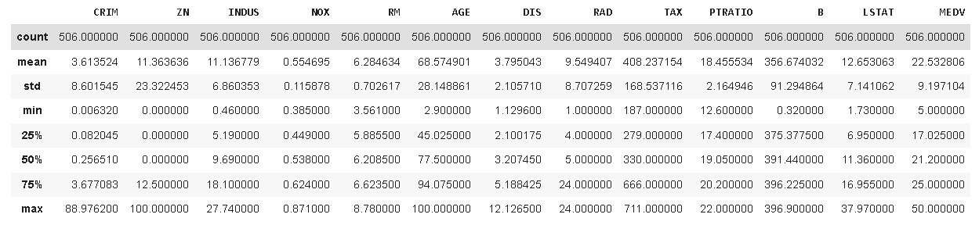
System Design & Implementation
Data set description

Slide 12
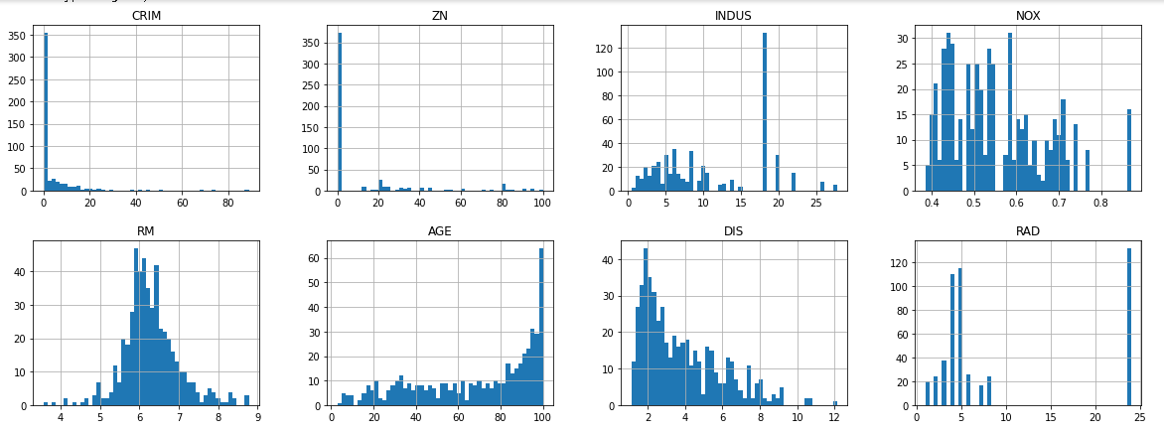
System Design & Implementation
Data set description

Slide 13
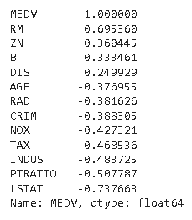
System Design & Implementation
Correlation in Data set
we can see a Correlation between various attributes in our data set with our main attribute (MEDV) .
RM : which is the avg No. of rooms in an house has a strong positive correlation with MEDV(Price).
while LSTAT which is % of lower status of the population has a strong but negative correlation with MEDV(Price).

Slide 14
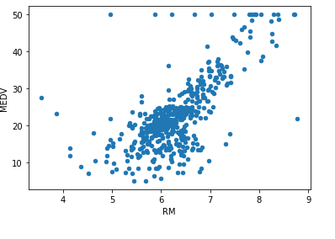
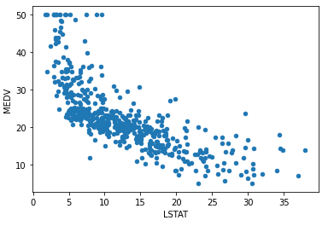
System Design & Implementation
Correlation in Data set

Slide 15
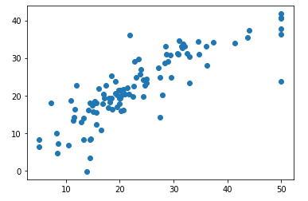
System Design & Implementation
Final Predictions
we have split our data set into training and testing set.
we have 404 instances in training data set and 102 in testing data set.
Linear regression performs, the task to predict a dependent variable (Price) based on a given independent variables (13 attributs).

Slide 16
System Design & Implementation
Final Predictions
we have split our data set into training and testing set.
we have 404 instances in training data set and 102 in testing data set.
Linear regression performs, the task to predict a dependent variable (Price) based on a given independent variables (13 attributs).

Slide 17
Future Scope
This paper presents the visualization techniques and classification algorithms that can be used for predicting the crimes and helps the law agencies.
In future, there is a plan for applying other classification algorithms on the crime data and improving the accuracy in prediction.
On other direction, we will be trying to build an Android App for the live capture of the realistic data and updating the results by using this new data frequently, that will be helpful in better prediction and providing the general information to the public for the awareness of trends in the crime.

Slide 18
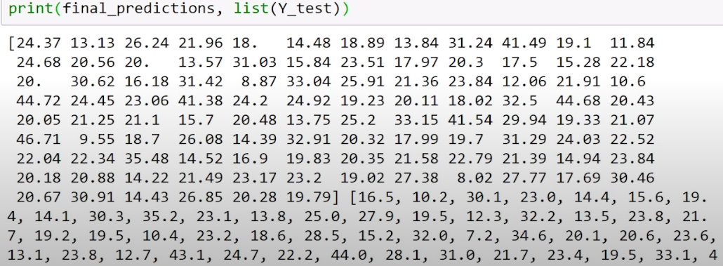
CONCLUSION
Created a ML Model for House Price Prediction with Accuracy of 80%.
Accuracy of this Model can be Further Increase by Training and Testing the model using large data set.
Final_Predictions

Slide 19
References
https://archive.ics.uci.edu/ml/machine-learning-databases/housing/
https://www.analyticsvidhya.com/blog/2015/01/scikit-learn-python-machine-learning-tool/
https://jupyter.org/try-jupyter/retro/notebooks/?path=notebooks/Intro.ipynbexamples/HEAD?filepath=demo.ipynbhttps://matplotlib.org/stable/users/getting_started/

Slide 20
Thank You

